Slide 1
21EES101T-ELECTRICAL AND ELECTRONICSENGINEERING UNIT 5
Unit-5–Power Engineering
Electrical supply system- simple layout of Generation, transmission and Distribution of power, Typical AC and DC power supply schemes, overview on substation equipment with key diagram of 11kV/400 V indoor substation- Introduction to smart grid.
Safety Measures in Electrical systems- Basic Principle and importance of Earthing, precautions for Electric shock- safety devices
Introduction to renewable energy resources: Solar Photovoltaic-Introduction to energy storage systems-overview of battery, Fuel cell technologies-HEVs, PHEVs and EVs – EV, Charging station.
Practice session on different types of wiring circuits and safety measures

Slide 2
Electrical supply system
Electrical power is generated in power stations which are mostly located in remote places. This is because the generating stations are installed in the areas, where the resources for power generation are available. The bulk power generated is to be transmitted to different load centers. The transmission of electrical power is done at high voltages. The power received at the load centers is to be distributed to the consumers at normal voltage. There is a complex network of conductors between the power station and the consumers. This network is divided into major parts called transmission and distribution systems. Generation, transmission and distribution systems combinedly known as electric supply system or electric power system
1. POWER GENERATION
Electrical power is generated normally at 11 kV or at 6.6 kV by number of generators in parallel. Generation at still higher voltage will impose some technical problems. Power generated at 11 kV is stepped upto 110 kV or 230 kV or 400 kV or 765 kV or still higher voltage with the help of power transformers.

Slide 3
2. TRANSMISSION SYSTEM-AC
The powers generated at the generating stations is transmitted at higher voltage to the main load centers. This transmission system is known as primary transmission system. The voltage level here may be 765 kV, 400 kV or 220 kV. In India, highest transmission voltage is 765 kV.
There are advantages when power is transmitted at high voltages:
The volume of conductor material required is low.
For a given amount of power transmitted, the current through the line is reduced, when the transmission system voltage is high. This reduces the line losses and hence efficiency of transmission is increased.
As the current is reduced the voltage in the line is reduced and hence the line regulation is improved.
The power from the main load centers is transmitted to different sub-load centers at voltages 33 kV, 66 kV or even at 110 kV. This part of transmission is known as secondary transmission system.
The primary transmission system employs overhead lines in general. The secondary transmission of power is either by means of OH lines or underground cable. In rural areas, OH lines are used and in city areas, underground cable system is used.

Slide 4
3. Distribution System
The power is received at the sub-load centre at voltages of 33 kV, 66 kV or 110 kV. The voltage level is stepped down to 11 kV at the sub-load centers. The power is distributed through the 11 kV lines, which runs along the main roads. This distribution system is referred to as primary distribution system.
Number of 11 kV/415 volts transformers are connected enroute 11 kV lines. Now the power is distributed through distribution lines, which run along all the streets of town/city/villages. This distribution line is called a distributor. The power is distributed with the help of 3-phase, 4-wire lines/cables. Voltage levels available are 1-phase or 230 V and 3-phase 415 volts. The lines feeding the power from the distribution transformer to the distributors are called feeders.
From the distributors, power is supplied to the consumers by means of lines called service lines. The feeder distribution and service lines combinedly, form the secondary distribution system which is shown in following fig. The distributors may be radial or ring. The secondary distribution of power is by means of ac only. This is because all the loads are designed to work on ac only, which are most efficient and less in cost.

Slide 5
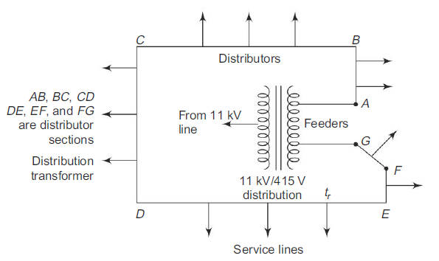
Main Components of Transmission and Distribution Systems
(i) Conductors, which are used to carry the electrical power from one place to another place.
(ii) Supports, which may be RCC poles, MS, tubular poles or towers. These are used to keep the conductors at a proper height from the ground.
(iii) Cross arms, which are attached to the poles or towers and are used to support the conductors.
(iv) Insulators, which are used to isolate the conductors at higher potential from the ground.
(v) Miscellaneous items like lighting arresters, ground wires, stay wires, etc.

Slide 6
COMPARISON OF OVERHEAD (OH) AND UNDERGROUND (UG) SYSTEMS
In city area, secondary distribution of power is done by UG cable system. Sometimes the primary distribution is by means of UG cable system. The OH line and UG cable systems are compared based on the following factors.
(i) Public Safety: UG cable is preferred, as there is less chance of any hazard to the public.
(ii) Initial cost: the initial investment on UG cable system is about 10 times the rate on OH line system. So, OH line system is preferred.
(iii) Flexibility: OH line system is more flexible than the UG cable system. OH line system can be modified easily.
(iv) Faults: The chances of occurrence of fault in an UG cable system is less when compared to the OH line system, as it is exposed to the atmosphere.

Slide 7
(v) Appearance: The general appearance of UG cable system is better. (vi) Fault location and Repair: Fault location and rectification of fault is easier in OH line system.
(vii) Useful life: The useful life period of an OH line system is only 50% that of UG cable system.
(viii) Maintenance cost: The maintenance cost of UG cable system is low, as the chance of fault is less in an UG cable system.
(ix) Interference with communication circuits. It is less with an UG cable system and more with an OH line system.
From the above comparison, it is clear that systems have advantages and limitations. However in city areas we bother only about safety and not about the economics involved. So in this condition, UG cable system is preferred.

Slide 8
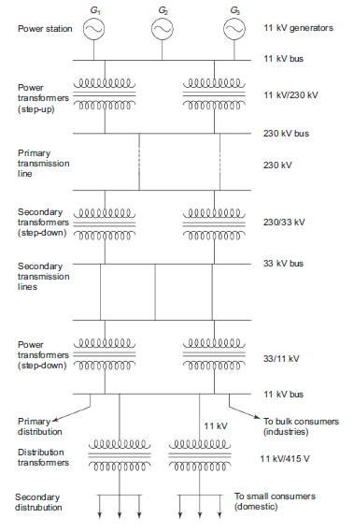
Simple layout of Generation, Transmission and Distribution of power
OR
Simple layout of Electrical Power System

Slide 9
Transmission System-DC
When power is transmitted by DC, there are a lot of advantages when compared to AC transmission systems.
The amount of insulation required is less in dc transmission as compared to that for ac transmission.
The size of towers, cross arms required are small for dc transmission system.
(iii) It improves the stability of the system.
(iv) Power factor of dc transmission system is unity.
(v) There is no changing current.
(vi) There is skin effect. Skin effect increases the effective resistance of the line conductors.
The main disadvantages of HVDC transmission are—
There is no equipment like a transformer, available for step-up or step-down the voltage. So this has to be done on the ac side only.
Power cannot be generated at higher voltages because of commutation problem (iii) There are limitations with HVDC switching devices and circuit measures.
The HVDC transmission system is more economical when the distance of transmission is more than 600 km for OH line.

Slide 10
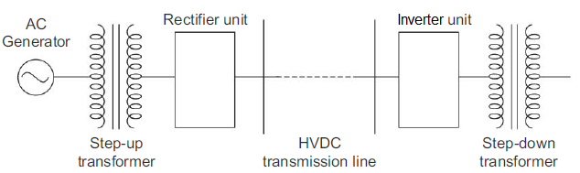
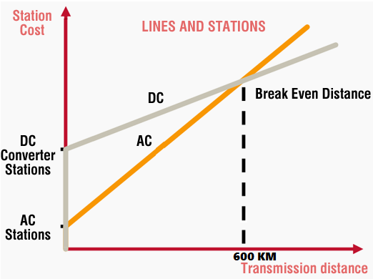
The components used in a substation for dc transmission purpose are more and are shown in following fig. The capital cost of dc transmission system is higher when compared to that of ac transmission system, when the length of the transmission line system is less than 600 km, and less when the length of the transmission line system is greater than 600 km.

Slide 11
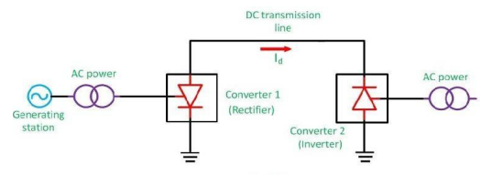
Types of DC link:
For connecting two networks or system, various types of HVDC links are used. HVDC links are classified into three types. These links are explained below:
1) Monopolar link: It has a single conductor of negative polarity and uses earth or sea for the return path of current. Sometimes the metallic return is also used. In the Monopolar link, two converters are placed at the end of each pole. Earthling of poles is done by earth electrodes placed about 15 to 55 km away from the respective terminal stations. But this link has several disadvantages because it uses earth as a return path. The monopolar link is not much in use nowadays.
Monopolar DC link

Slide 12
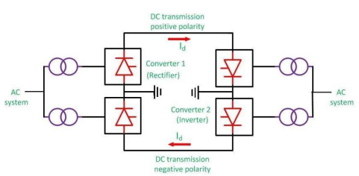
2.Bipolar link: The Bipolar link has two conductors one is positive, and the other one is negative to the earth. The link has converter station at each end. The midpoints of the converter stations are earthed through electrodes. The voltage of the earthed electrodes is just half the voltage of the conductor used for transmission the HVDC. The most significant advantage of the bipolar link is that if any of their links stop operating, the link is converted into Monopolar mode because of the ground return system. The half of the system continues supplies the power. Such types of links are commonly used in the HVDC systems.
Bipolar DC link

Slide 13
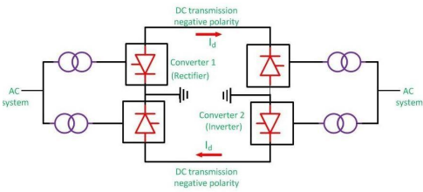
3) Homopolar link : It has two conductors of the same polarity usually negative polarity, and always operates with earth or metallic return. In the homopolar link, poles are operated in parallel, which reduces the insulation cost. The homopolar system is not used presently.
Homopolar DC link

Slide 14
Equipment in a Transformer Sub-Station
The equipment required for a transformer sub-station depends upon the type of sub-station, service requirement and the degree of protection desired. However, in general, a transformer sub-station has the following main equipment :
1.Bus-bars
When a number of lines operating at the same voltage have to be directly connected electrically, bus-bars are used as the common electrical component. Bus-bars are copper or aluminium bars (generally of rectangular x-section) and operate at constant voltage. The incoming and outgoing lines in a sub-station are connected to the bus-bars. The most commonly used bus-bar arrangements in sub-stations are :
(i) Single bus-bar arrangement
(ii) Single bus-bar system with sectionalisation
(iii) Double bus-bar arrangement
2. Insulators
The insulators serve two purposes. They support the conductors (or bus-bars) and confine the current to the conductors. The most commonly used material for the manufacture of insulators is porcelain. There are several types of insulators (e.g. pin type, suspension type, post
insulator etc.) and their use in the sub-station will depend upon the service requirement. For example, post insulator is used for bus-bars.

Slide 15
A post insulator consists of a porcelain body, cast iron cap and flanged cast iron base. The hole in the cap is threaded so that bus-bars can be directly bolted to the cap.
3. Isolating switches
In sub-stations, it is often desired to disconnect a part of the system for general maintenance and repairs. This is accomplished by an isolating switch or isolator. An isolator is essentially a knife switch and is designed to open a circuit under no load. In other words, isolator switches are operated only when the lines in which they are connected carry no current.
4. Circuit breaker
A circuit breaker is an equipment which can open or close a circuit under normal as well as fault conditions. It is so designed that it can be operated manually (or by remote control) under normal conditions and automatically under fault conditions. For the latter operation, a relay circuit is used with a circuit breaker. Generally, bulk oil circuit breakers are used for voltages upto 66kV while for high (>66 kV) voltages, low oil circuit breakers are used. For still higher voltages, air-blast, vacuum or SF6 circuit breakers are used.

Slide 16
5. Power Transformers
A power transformer is used in a sub-station to step-up or step-down the voltage. Except at the power station, all the subsequent sub-stations use step-down transformers to gradually reduce the voltage of electric supply and finally deliver it at utilisation voltage. The modern practice is to use 3-phase transformers in sub-stations ; although 3 single phase bank of transformers can also be used. The use of 3-phase transformer (instead of 3 single phase bank of transformers) permits two advantages. Firstly, only one 3-phase load-tap changing mechanism can
be used. Secondly, its installation is much simpler than the three single phase transformers. The power transformer is generally installed upon lengths of rails fixed on concrete slabs having foundations 1 to 1·5 m deep. For ratings upto 10 MVA, naturally cooled, oil immersed transformers are used. For higher ratings, the transformers are generally air blast cooled.
6. Instrument transformers.
The lines in sub-stations operate at high voltages and carry current of thousands of amperes. The measuring instruments and protective devices are designed for low voltages (generally 110 V) and currents (about 5 A). Therefore, they will not work satisfactorily if mounted directly on the power lines. This difficulty is overcome by installing instrument transformers on the power lines. The function of these instrument transformers is to transfer voltages or currents in the

Slide 17
power lines to values which are convenient for the operation of measuring instruments and relays. There are two types of instrument transformers viz.
(i) Current transformer (C.T.) (ii) Potential transformer (P.T.)
(i) Current transformer (C.T.): A current transformer in essentially a step-up transformer which steps down the current to a known ratio. The primary of this transformer consists of one or more turns of thick wire connected in series with the line. The secondary consists of a large number of turns of fine wire and provides for the measuring instruments and relays a current which is a constant fraction of the current in the line. Suppose a current transformer rated at 100/5 A is connected in the line to measure current. If the current in the line is 100 A, then current in the secondary will be 5A. Thus the C.T. under consideration will step down the line current by a factor of 20.
(ii) Potential transformer (P.T.): It is essentially a step down transformer and steps down the voltage to a known ratio. The primary of this transformer consists of a large number of turns of fine wire connected across the line. The secondary winding consists of a few turns and provides for measuring instruments and relays a voltage which is a known fraction of the line voltage. Suppose a potential transformer rated at 66kV/110V is connected to a power line. If line voltage is 66kV, then voltage across the secondary will be 110 V.

Slide 18
7. Metering and Indicating Instruments
There are several metering and indicating instruments (e.g. ammeters, voltmeters, energy meters etc.) installed in a sub-station to maintain watch over the circuit quantities. The instrument transformers are invariably used with them for satisfactory operation.
8. Miscellaneous equipment
In addition to above, there may be following equipment in a sub-station :
(i) fuses
(ii) carrier-current equipment
(iii) sub-station auxiliary supplies

Slide 19
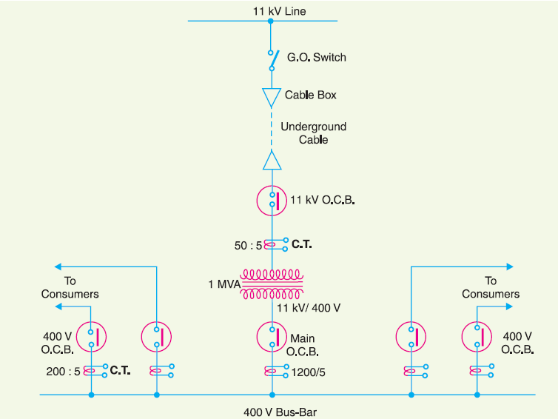
Key Diagram of 11 kV/400 V Indoor Sub-Station

Slide 20
The key diagram of this 11 kV/400 V sub-station can be explained as under :
(i) The 3-phase, 3-wire 11 kV line is tapped and brought to the gang operating switch installed near the sub-station. The G.O. switch consists of isolators connected in each phase of the 3-phase line.
(ii) From the G.O. switch, the 11 kV line is brought to the indoor sub-station as underground cable. It is fed to the H.T. side of the transformer (11 kV/400 V) via the 11 kV O.C.B. The transformer steps down the voltage to 400 V, 3-phase, 4-wire.
(iii) The secondary of transformer supplies to the bus-bars via the main O.C.B. From the busbars, 400 V, 3-phase, 4-wire supply is given to the various consumers via 400 V O.C.B. The voltage between any two phases is 400 V and between any phase and neutral it is 230 V. The single phase residential load is connected between any one phase and neutral whereas 3-phase, 400 V motor load is connected across 3-phase lines directly.
(iv) The CTs are located at suitable places in the sub-station circuit and supply for the metering and indicating instruments and relay circuits.

Slide 21
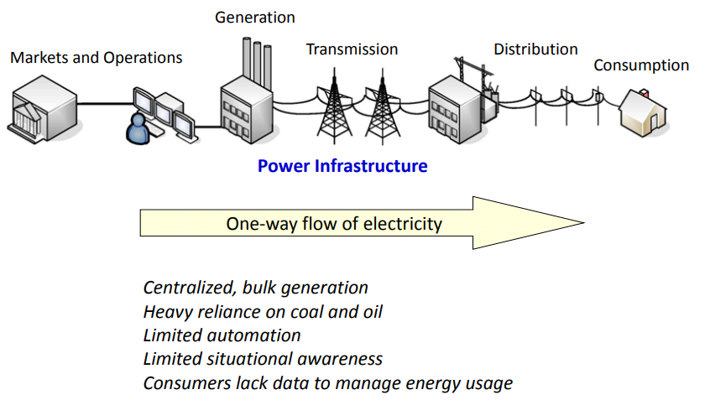
INTRODUCTION TO SMART GRID 1. TRADITIONAL POWER GRID

Slide 22
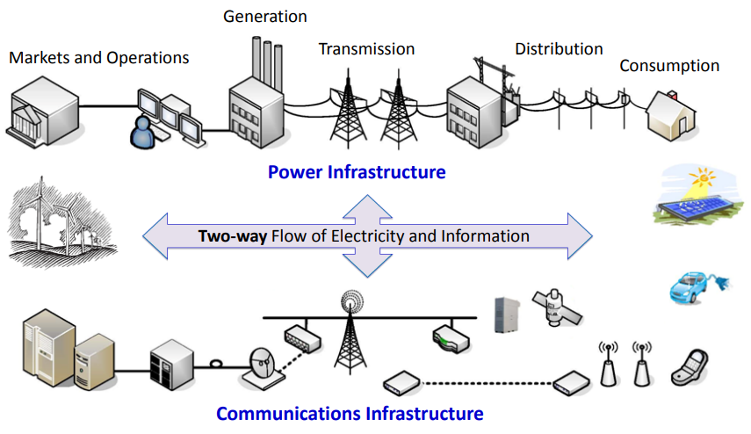
2. SMART GRID

Slide 23
Safety Precautions when Working with Electricity
1. Never touch or try repairing any electrical equipment or circuits with wet hands. It increases the conductivity of electric current.
2. Never use equipment with damaged insulation or broken plugs.
3. If you are working on any electrical socket at your home then always turn off the mains.
4. Always use insulated tools while working.(never use aluminium or steel ladder )
5. Electrical hazards include exposed energized parts and unguarded electrical equipment which may become energized unexpectedly -carries warning signs like “Shock Risk”. Always be observant such electrical signs.

Slide 24
6. when working electrical circuit always use appropriate insulated rubber gloves and goggles.
7. Never try repairing energized equipment. Always check that it is de-energized first by using a tester. When an electric tester touches a live or hot wire, the bulb inside the tester lights up showing that an electrical current is flowing through the respective wire.
8. Know the wire code of your country.
9. Always use a circuit breaker or fuse with the appropriate current rating. Circuit breakers and fuses are protection devices that automatically disconnect the live wire when a condition of short circuit or over current occurs. The selection of the appropriate fuse or circuit breaker is essential.

Slide 25
ELECTRICAL SAFETY DEVICES
It is extremely important to have various safety devices to protect from fire and electrocution.
FUSE: A fuse is an electrical safety device that has the capability to protect an electric circuit from excessive electric current. It is designed to allow current through the circuit, but in the event that the current exceeds some maximum value it will open, severing the circuit.
Circuit breaker: Circuit breakers are devices that protect circuits from overload current conditions. They do the same job as fuses, but they are not destroyed when activated.

Slide 26
EARTHING
The potential of the earth is considered to be at zero for all practical purposes.
Earthing is to connect any electrical equipment to earth with a very low resistance wire, making it to attain earth’s potential.
This ensures safe discharge of electric energy, which may be due to reasons like failure of the insulation, line coming in contact with the casing etc.
Earthing brings the potential of the body of the equipment to ZERO i.e. to the earth’s potential, thus protecting the operating personnel against electrical shock.

Slide 27
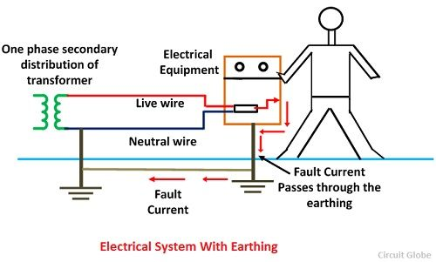
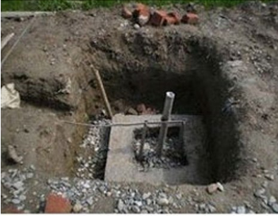
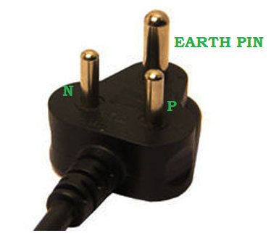
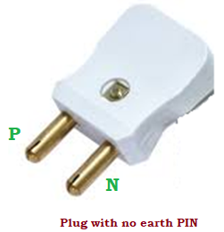

Slide 28
Importance of Earthing

Slide 29
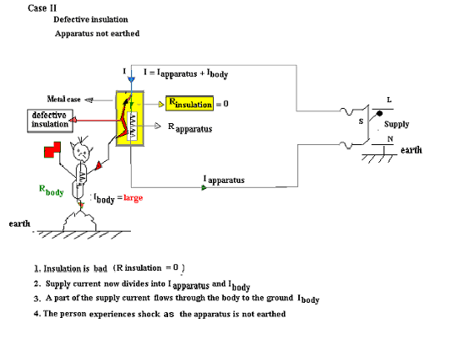

Slide 30
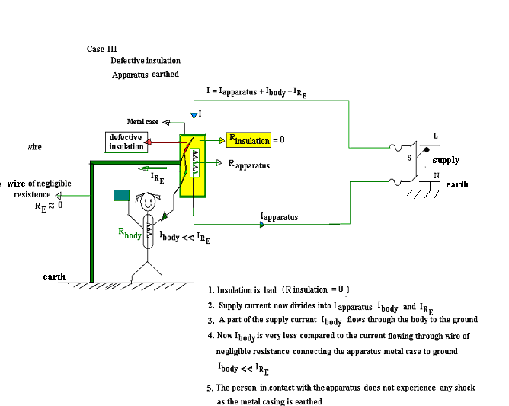

Slide 31
EARTHING AND ITS NECESSITY
Earthing means generally connected to the mass of the earth. It shall be in such a manner as to ensure at all times an immediate and safe discharge of electric current due to leakages, faults, etc.
All metallic parts of every electrical installation such as conduit, metallic sheathing, armouring of cables, metallic panels, frames, iron clad switches, instrument frames, household appliances, motors, starting gears, transformers, regulators etc, shall be earthed using one continuous bus (barewire). If one earth bus for the entire installation is found impracticable, more than one earthing system shall be introduced. Then, the equipment and appliances shall be divided into sub-groups and connected to the different earth buses.

Slide 32
The earthing conductors, when taken out doors to the earthing point, shall be encased in pipe securely supported and continued up to a point not less than 0.3 more below ground level. No joints are permitted in an earth bus. Whenever there is a lightning conductor system installed in a building, its earthing shall not be bonded to the earthing of the electrical installation.
Before electric supply lines or apparatus are energized, all earthing system shall be tested for electrical resistance to ensure efficient earthing. It shall not be more than two ohms including the ohmic value of earth electrode.
Types of Earthing
Plate Earthing
Pipe Earthing

Slide 33
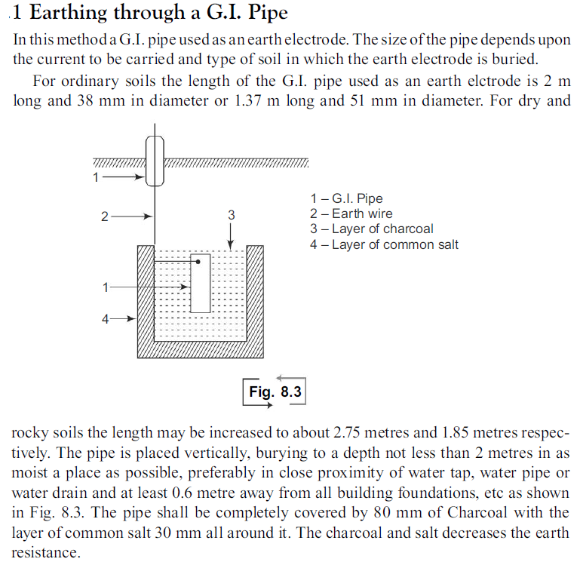

Slide 34
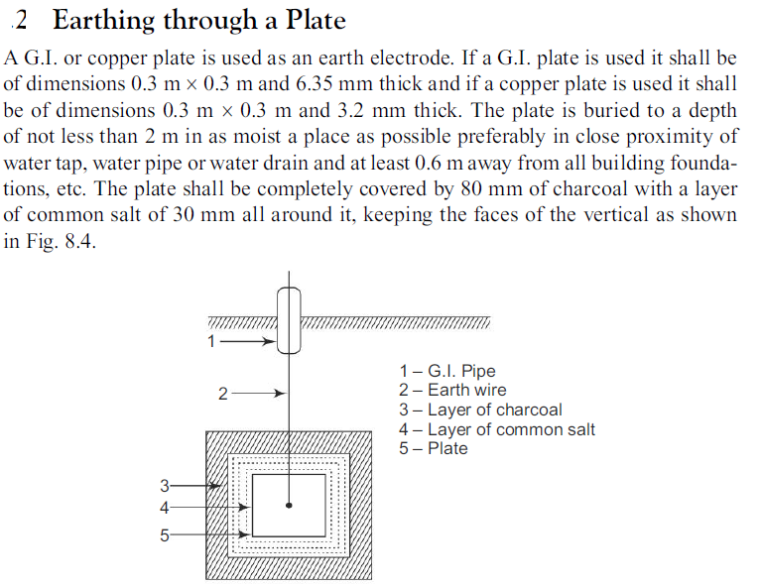

Slide 35
RENEWABLE ENERGY
Renewable energy is a term used to refer to forms of energy that are naturally obtained from the environment and from sources that can be replenished naturally.
These include solar energy, wind energy, geothermal energy, hydropower, tidal and biomass.
Advantages of Renewable Energy
Less maintenance cost as most sources entail few or no moving parts, hence, less mechanical damages.
Economical and can cut costs spent on fossil fuel.
They emit little or no waste in the environment.
Renewable energy sources do not deplete.

Slide 36
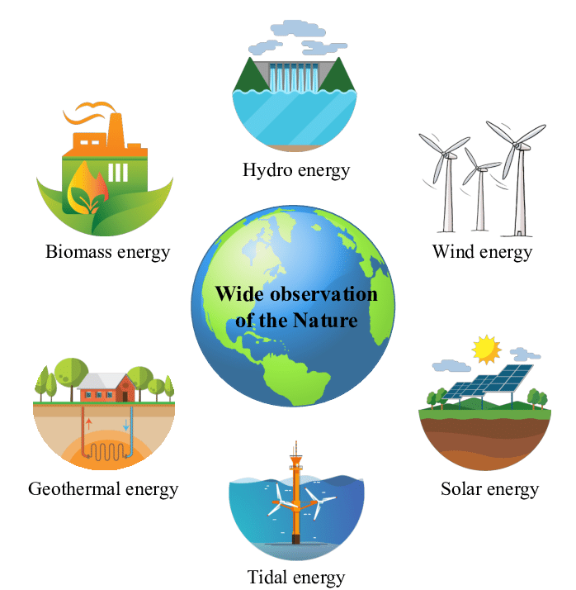

Slide 37
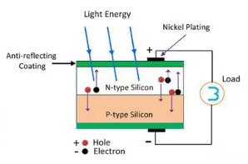
Solar Photovoltaic system
A solar cell (also known as a photovoltaic cell or PV cell) is defined as an electrical device that converts light energy into electrical energy through the photovoltaic effect. A solar cell is basically a p-n junction diode. Solar cells are a form of photoelectric cell, defined as a device whose electrical characteristics – such as current, voltage, or resistance – vary when exposed to light.

Slide 38
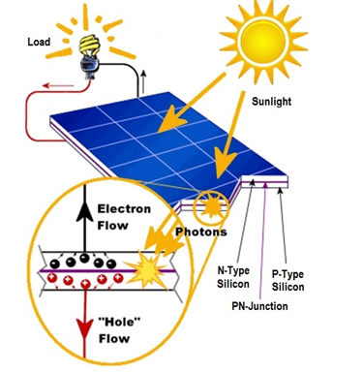
Solar cells, a type of semiconductor device that efficiently absorbs solar radiation and converts it into electrical energy, are also known as photovoltaic cells because of their photo-voltaic effect using various potential barriers.
A photovoltaic cell is also called a solar cell. It is a semiconductor device which converts sunlight into DC power using the photoelectric effect. Practically, all solar cells are photodiodes made of semiconductor material like silicon.

Slide 39
A solar cell works in three steps: Photons in the sunlight hit the solar cell and are absorbed by the semiconductor material. Negatively-charged electrons are knocked off from their atoms and start flowing in the same direction to produce electric current.
Output of a single solar cell is very small, a large number of solar cells are interconnected to form a solar module, combination of solar modules is called panel and combination of panels is called solar array. It is done to get the required power output from a PV system.
When the solar cells are connected in series their voltage increases as much as the number of cells connected in series. But the current remains the same. When cells are connected in parallel, voltage remains constant, same as that of one cell but current gets multiplied

Slide 40
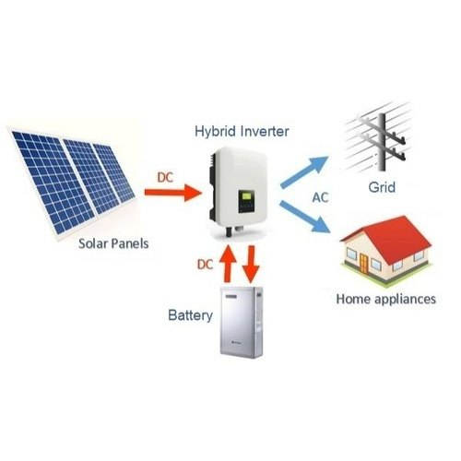
Solar Photovoltaic system

Slide 41
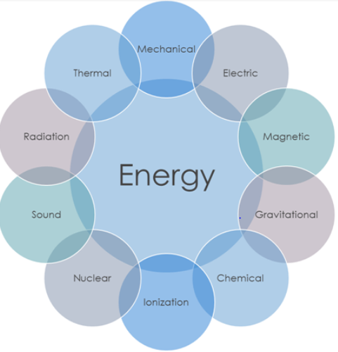
Introduction to Energy Storage
Energy storage systems have been in use for a very long time, for diverse applications.
Quantitative property held by an object or a system that can be consumed to perform work or convert the form of energy.
retention of anything, whether physical or virtual, for (possible) usage in the future.
(i) Portable electronics
(ii) Uninterruptible Power Supplies (UPS)
(iii) Energy offset for renewable energy

Slide 42
Overview of Battery
Batteries are a collection of one or more cells whose chemical reactions create a flow of electrons in a circuit. All batteries are made up of three basic components: an anode (the ‘+' side), a cathode (the ‘-' side), and some kind of electrolyte (a substance that chemically reacts with the anode and cathode).
Types:
1. Lead acid
2. Nickel cadmium
3. Nickel metal hydride
4. Lithium ion
5. Sodium sulfur
6. Redox flow

Slide 43
Fuel cell technologies
The fuel cell technology is a clean technology with low chemical pollution and is a chemical engineering way of producing energy based on electrochemical energy conversion of chemical energy of hydrogen and oxygen into electricity and heat which produces only water as the by product.

Slide 44
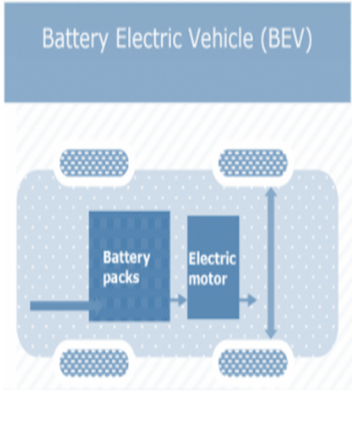
Types of EVS
(i) BEV (Battery Electric Vehicle)
EVs run on battery power without an internal combustion engine’s assistance, they can run much faster on a single charge than hybrid vehicles.
They’re also known as battery electric vehicles, or BEVs. That’s what distinguishes them from hybrids that run on battery power with assistance from internal combustion engines

Slide 45
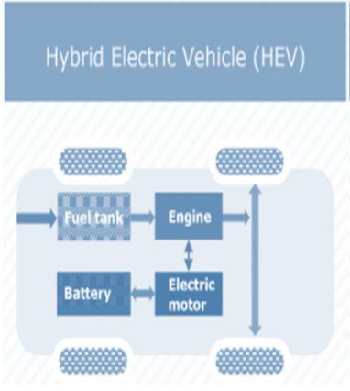
(ii) HEV (Hybrid Electric Vehicle)
HEVs run on both an internal combustion engine and an electric motor that uses energy stored in a battery. Unlike most electric vehicles, however, HEV drivers charge their batteries via regenerative braking.
Regenerative braking stores the kinetic energy used to stop the car to charge its battery and help the internal combustion engine accelerate the vehicle.

Slide 46
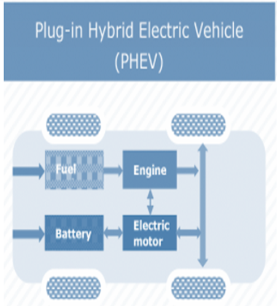
(iii) PHEV (Plug in Hybrid
Electric Vehicle)
PHEVs expand on the concept of the standard hybrid vehicle. They have both an internal combustion engine and a battery-powered electric motor. This allows the battery to store enough power to feed the electric motor and in turn decrease your gas usage by as much as 60 percent.
This can save you time and money at the gas pump. PHEVs can travel up to 40 miles on electric power alone, rather than a couple of miles with a standard hybrid vehicle.

Slide 47
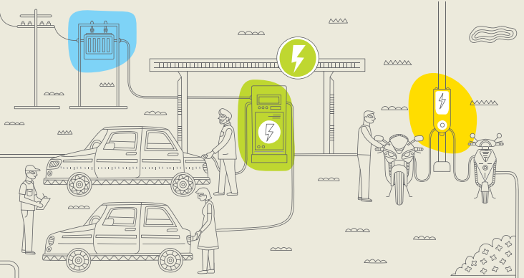
EV Charging station
EV charging points are primarily defined by the power (in kW) they can produce and therefore what speed they are capable of charging an EV. While connector types are also a key issue, most EVs are equipped with two or more cables to allow the use of chargers with different connector outlets.

Slide 48
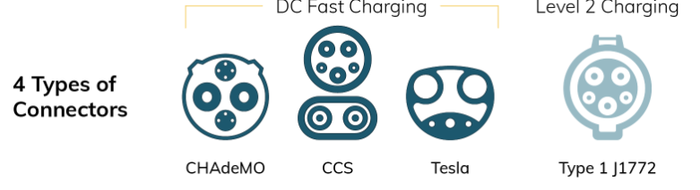
4 categories:
The Process
Time
Price
EVs are better for the environment
CHARGE POINT TYPES
(i) Slow charging (up to 3kW)
(ii) Fast charging (7-22kW)
(iii) Rapid chargers (43-50kW)
‘Charge de Move’
Nissan, Toyota,
and Mitsubishi
Combined Charging
System (all EVs
except Tesla)
DC Fast Charging
Only Tesla
all EVs except Tesla

